Slide 1
A New Framework of Memory for Learning (Summarized)
John Tan Chong Min
20 Dec 2022
Special thanks for discussing and improving my ideas in NeurIPS 2022:
Wu Shuchen (Abstraction, Hashtable and overall discussion)
Joseph Campbell (Reinforcement Learning)
Markus Hiller (Continual Learning)

Slide 2
Aim
To seek biological / neuroscience and psychology inspirations for how humans learn fast, and model it into AI
Do not need to replicate faithfully the detailed mechanisms behind human thinking
Just need to take broad concepts and apply it

Slide 3
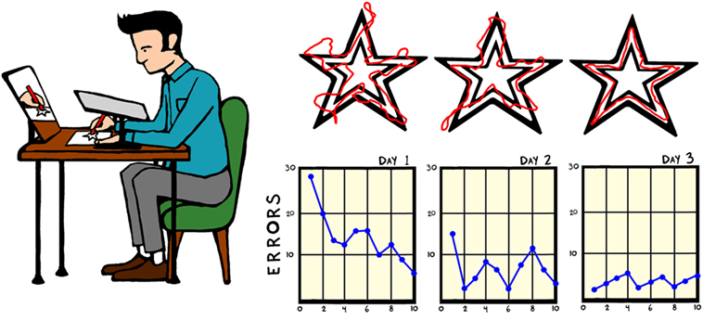
The case of Henry Molaison
HM did not have a hippocampus
He did not have the ability to form new memories, and had no episodic or semantic memories
Although he could not recall having done the star tracing task, he could still get better at it (procedural memory)
Image Extracted from: https://kids.frontiersin.org/articles/10.3389/frym.2018.00045

Slide 4
HM and Modern Neural Networks
Modern Neural Networks are like HM
There is (mostly) no memory storage nor retrieval other than updating weights
Weight updating is akin to procedural memory
Fast inference, but slow learning
Memory formation and retrieval is akin to episodic/semantic memory
Slow inference, but fast learning
Memory is useful for learning!!

Slide 5
Memory in Reinforcement/Continual Learning

Slide 6
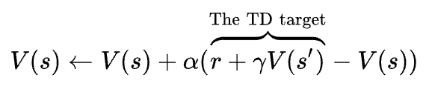
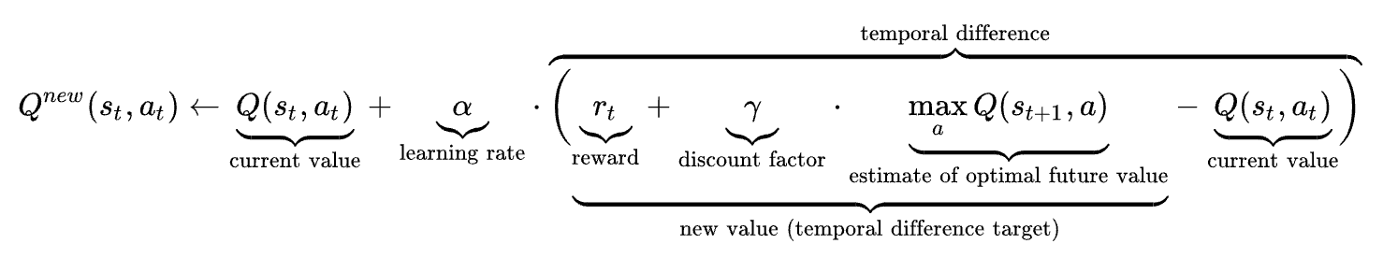
Typical Reinforcement Learning is Slow
Walled Maze
Typically updated by one-step Bellman update (Temporal Difference Error)
Takes as many updates as the path length to update the states with the final value
☺
Legend:
☺
Agent
Door

Slide 7
Should we model the Markov Decision Process of the world?
Recent works have tried to utilize world models
MuZero
Dreamer v2
To get probability of transition, we would need many samples to learn it accurately
Difficult to define state transition probability when number of possible states is unbounded
Multi-agent systems can be non-Markovian
0.5
S2
S1
0.5
S3

Slide 8
A New RL Paradigm
0.5
S2
No need to model Markov Decision Process – impractical to model environments with unbounded state and action spaces
No need to model probability of transition – just need to see how often the next state is stored based on memory
Just need to remember experienced transitions and then retrieve it the next time we encounter a similar state
No reward modelling needed.
Use goal-directed (fast) and memory retrieval (slow) mechanisms
S1
0.5
S3
Key (State) | Value 1 (Next State) | Value 2 (Action)
1 | 2 | A
1 | 3 | A
2 | 1 | A
3 | 2 | A

Slide 9
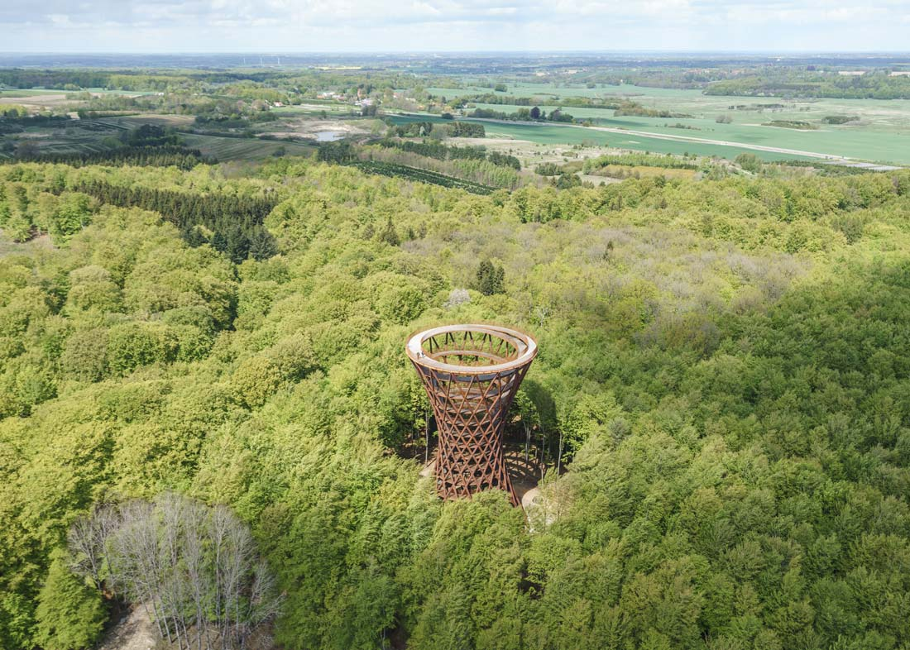
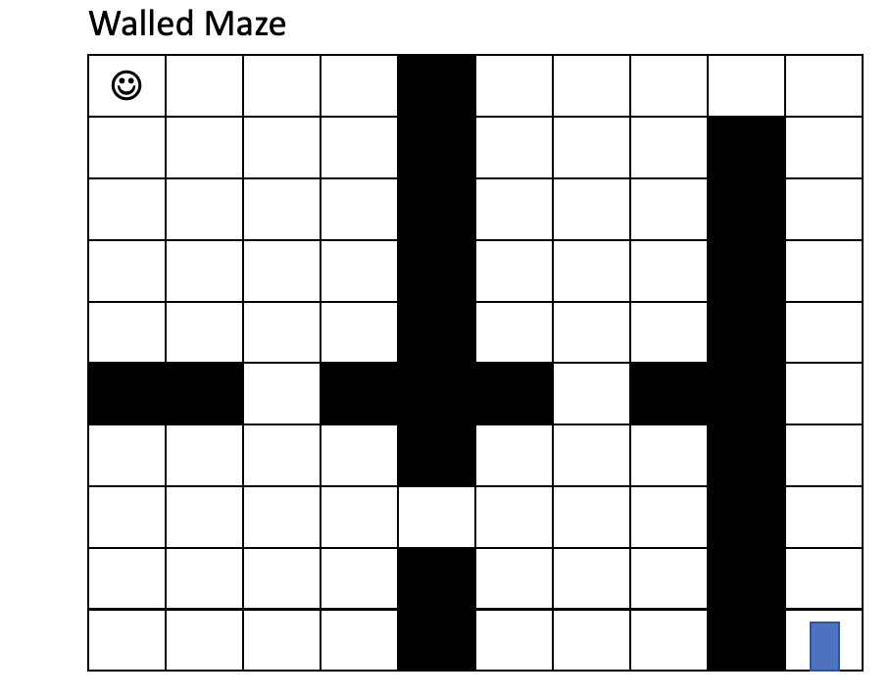
Goal-Directed Exploration
To ensure memory only stores relevant transitions, we cannot explore everything
We use a goal-directed exploration
Human exploration is typically goal-driven, by some intrinsic want like food, shelter, point-to-point navigation
Difficult problem to dissect overall goal into sub-goals for the agent to fulfil
Difficult problem also in generating the right heuristic to head towards the direction of the goal
With hippocampal replay to train the goal-directed network, no need for heuristic!!

Slide 10
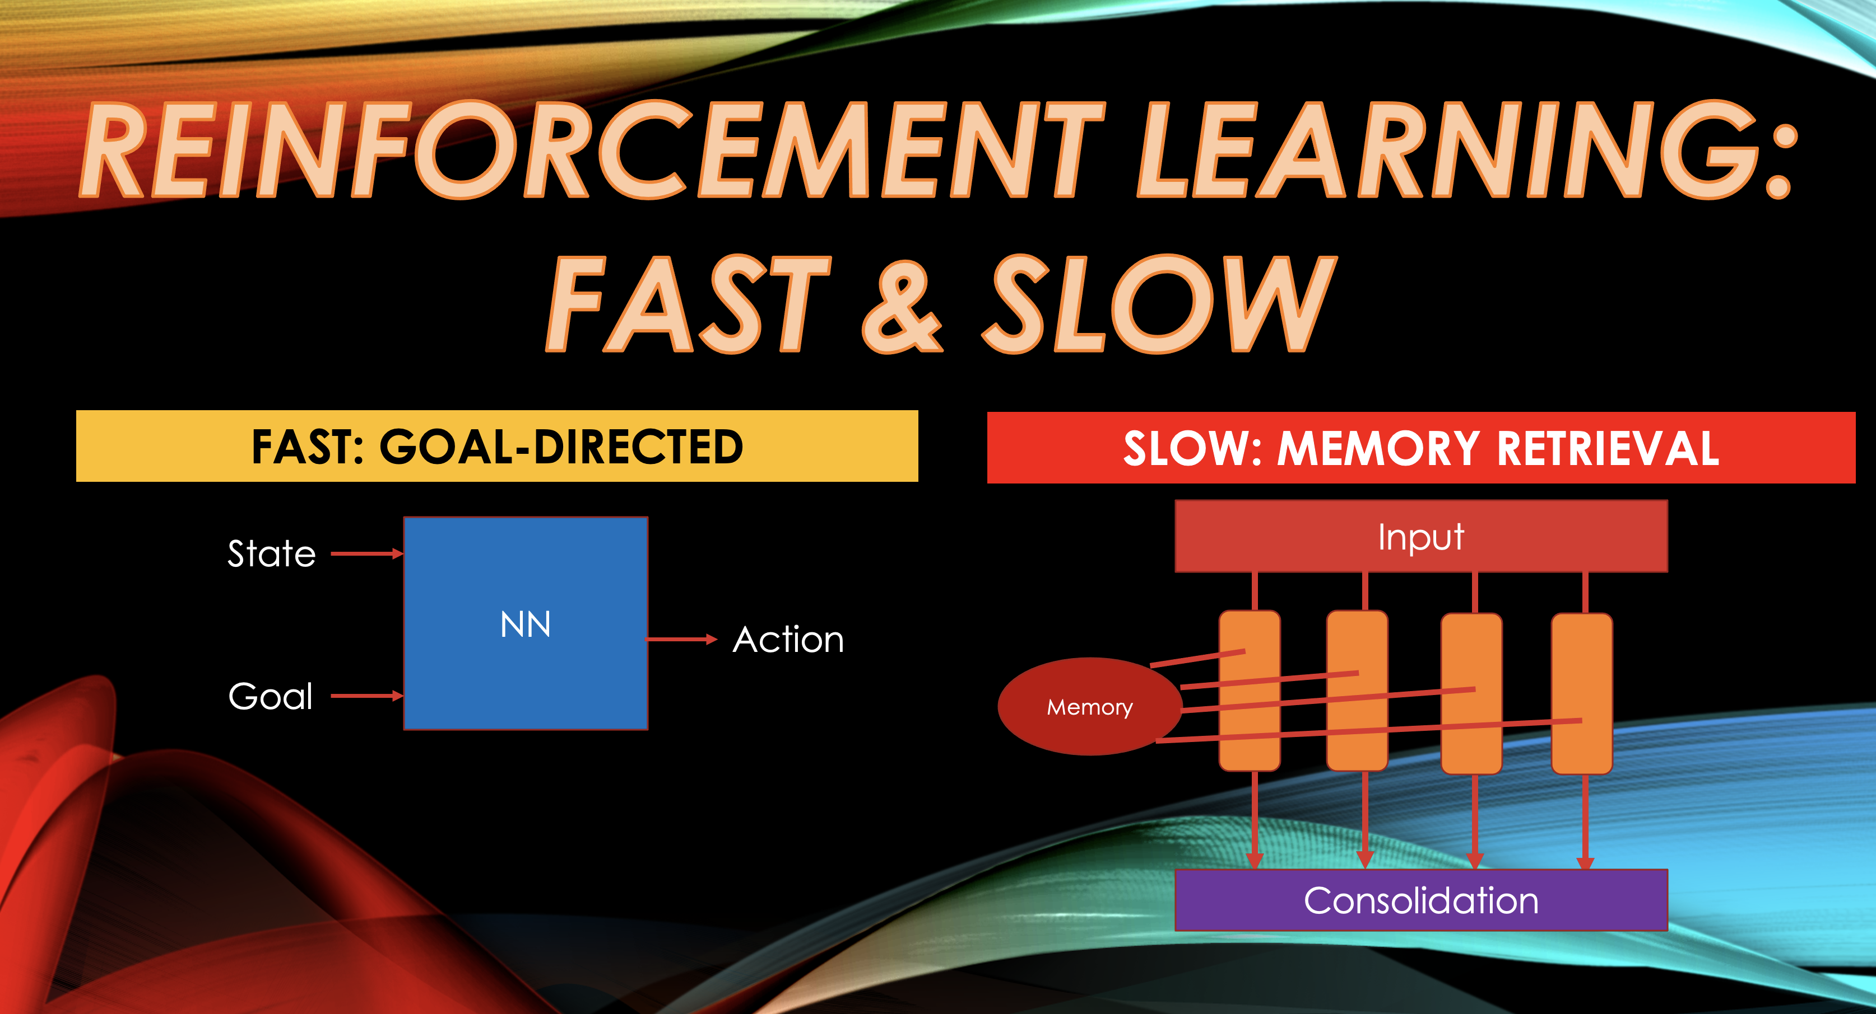

Slide 11
Two Networks – Fast and Slow
Fast (System 1): Neural network predicts best action given a goal
Slow (System 2): Memory retrieval network to match current state and get required action and next state from memory
Can also lookahead multiple timesteps to sample more possible outcomes
State
NN
Action
Goal
Input
Memory
Consolidation

Slide 12
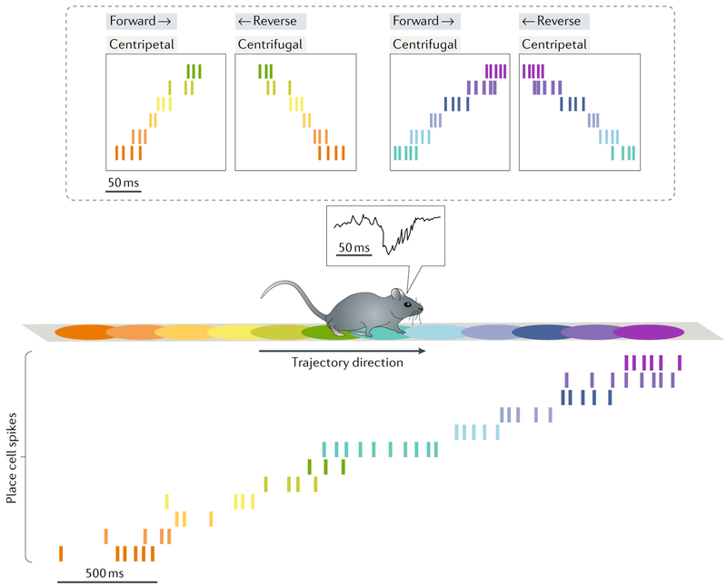
Fast Goal-Directed Neural Network
Fast Neural Network Update
(at each time step)
Previous states replay: Update fast neural network such that conditioned on the current state as the goal state, the past history of states as the start state, the network will return the action taken at that previous state
Future states replay (only if trajectory found): Update fast neural network such that conditioned on all intermediate states in System 2 lookahead as goal states, the first state will return action for the current timestep
C
G
G
G
C
C
C
G
State
NN
Action
Goal
Figure extracted from Joo, H. R., & Frank, L. M. (2018). The hippocampal sharp wave-ripple in memory retrieval for immediate use and consolidation. Nature reviews. Neuroscience, 19(12), 744–757. https://doi.org/10.1038/s41583-018-0077-1

Slide 13
Slow Memory Retrieval Network
Uses parallel processing
Each parallel branch is like a minicolumn in the neocortex
Takes the starting state and then reference memory for next state
If more than one match, randomly pick one for the next state
If next state is goal state, break
Continue with next state as the key to reference memory
Repeat until X lookahead timesteps
All parallel branches will come back with a response
See which branch has shortest trajectory to goal state, use the first action
Input
Memory
Consolidation

Slide 14
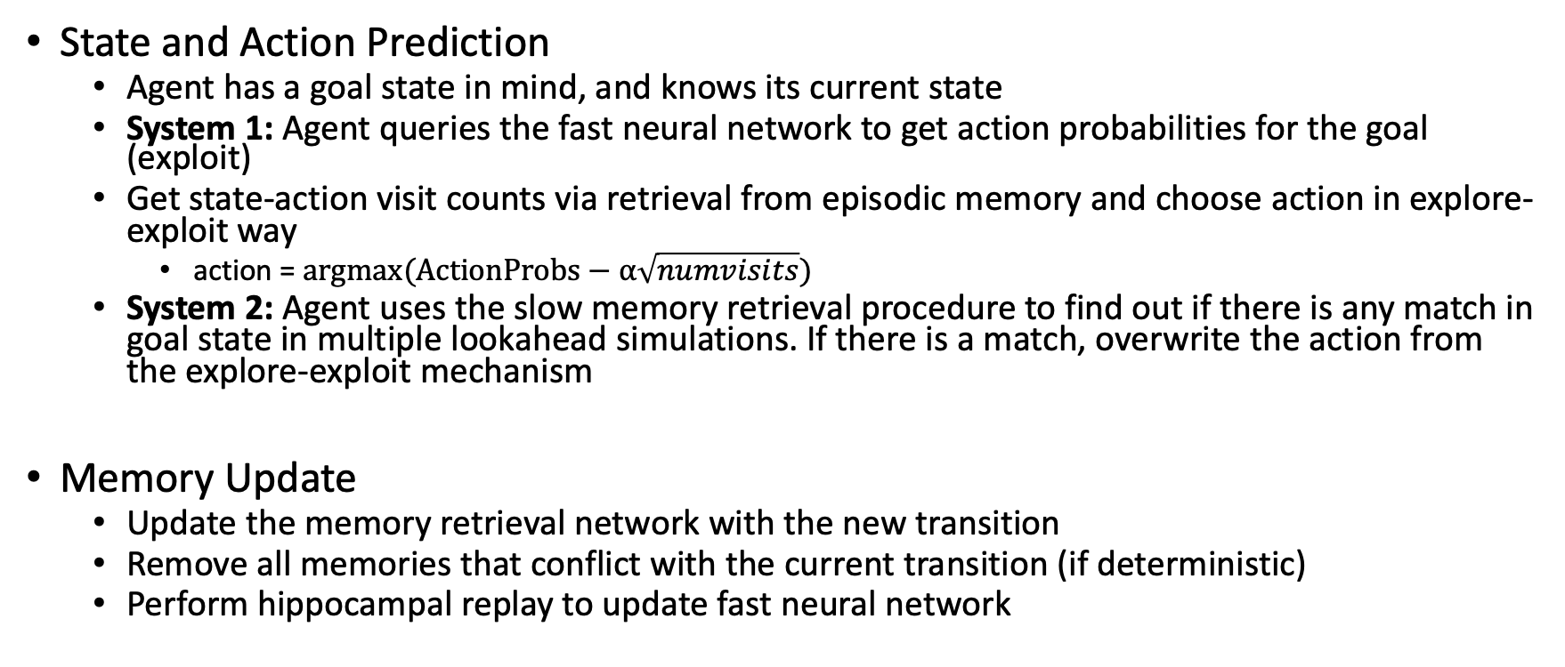
Overall Procedure using Memory
State and Action Prediction
Agent has a goal state in mind, and knows its current state
System 1: Agent queries the fast neural network to get action probabilities for the goal (exploit)
Get state-action visit counts via retrieval from episodic memory and choose action in explore-exploit way
action = $argmax(ActionProbs−α\sqrt{numvisits})$
System 2: Agent uses the slow memory retrieval procedure to find out if there is any match in goal state in multiple lookahead simulations. If there is a match, overwrite the action from the explore-exploit mechanism
Memory Update
Update the memory retrieval network with the new transition
Remove all memories that conflict with the current transition (if deterministic)
Perform hippocampal replay to update fast neural network

Slide 15
Experiments
Navigating in a 10x10 grid maze with obstacles

Slide 16
Experimental Validation
Start State State to be (0, 0) and End State to be (9, 9) in a 10x10 grid
Actions: Up, Down, Left, Right
See if agent can learn to navigate to goal state efficiently
Agent cannot see the entire grid, only knows its position and goal position
Q-Learning vs Memory-Based Approach

Slide 17
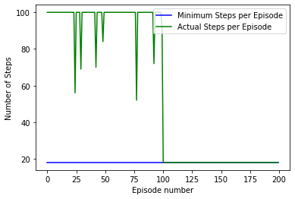
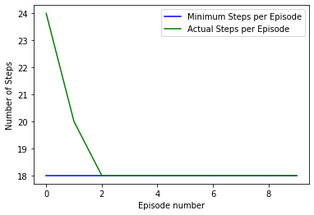
Results
Q-Learning
(first 100 episodes random policy,
last 100 episodes greedy)
Memory-based

Slide 18
Too Easy? Harder Experiments!
Set Start and End State to be changing in a 10x10 grid
Obstacles which block certain squares
Obstacle locations change every 10 episodes
Memory Based Approach with Ablations
Without Slow Memory Retrieval
Without Fast Goal-Directed Network
Without Fast Goal-Directed Network and Slow Memory Retrieval

Slide 19
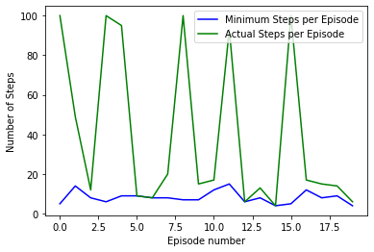
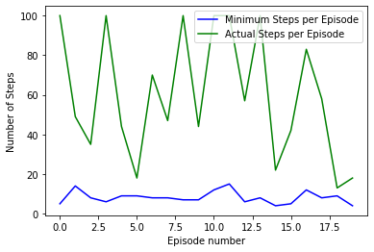
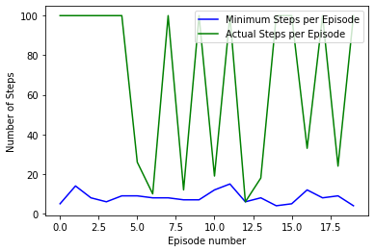
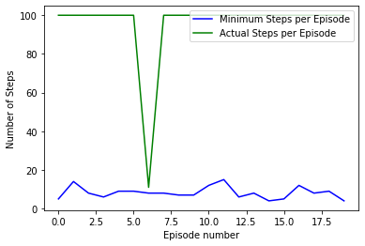
Results
Memory Based:
(baseline) + 629 steps
from minimum
Without
Slow: + 1036 steps
from minimum
Without
Fast: + 1184 steps
from minimum
Without
Fast & Slow: + 1747 steps
from minimum

Slide 20
Results
Memory mechanism is very robust and can learn even when environment changes
Count-based mechanism alone is not sufficient to learn well; there is a great benefit to using memory for learning
Value-based systems are slow to converge and not adaptable in a changing environment

